Slide 1
airline_passenger_satisfaction
Analyzation

Slide 2
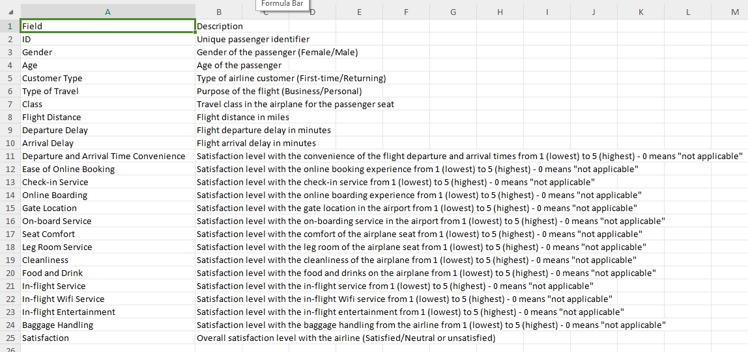
Describtion of data set

Slide 3
Data Set
Airline Passenger Satisfaction
Customer satisfaction scores from 120,000+ airline passengers, including additional information about each passenger, their flight, and type of travel, as well as ther evaluation of different factors like cleanliness, comfort, service, and overall experience.

Slide 4
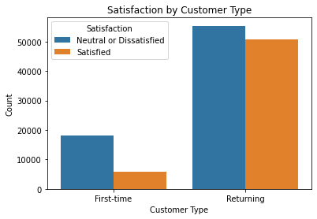
percentage of airline passengers are satisfied

Slide 5
The bar chart shows the percentage of satisfied vs dissatisfied passengers. The two categories presented are:
Neutral or Dissatisfied: Representing a higher percentage (over 50%), indicating that more passengers fall into this group.
Satisfied: Representing a lower percentage, around 40-45%.
This suggests that there is a larger portion of passengers who are either neutral or dissatisfied compared to those who are satisfied with their airline experience. The chart effectively highlights the gap between the two groups.

Slide 6
Does it vary by customer type?

Slide 7
First-time Passengers:
A larger portion is Neutral or Dissatisfied, with relatively fewer passengers satisfied.
This suggests that new customers may be less pleased with their experience or have higher expectations that weren't met.
Returning Passengers:
Though many are Neutral or Dissatisfied, the number of Satisfied passengers is significantly higher compared to first-time passengers.
Returning customers generally appear to have a better experience, or are more loyal, resulting in higher satisfaction levels.
Insights:
Returning passengers may benefit from familiarity with the airline's services or enjoy perks like loyalty programs, which may positively influence satisfaction.
First-time passengers may require better service or experiences to encourage them to return and become loyal customers.

Slide 8
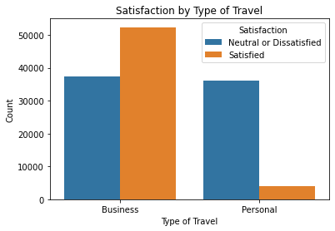
satisfaction by type of travel

Slide 9
This bar chart shows Satisfaction by Type of Travel, comparing satisfaction levels for Business and Personal travel.
Business Travelers:
The majority of business travelers are Satisfied, with a higher count compared to those who are neutral or dissatisfied.
This could suggest that business travelers generally receive better service, potentially due to premium seats or additional amenities offered during business travel.
Personal Travelers:
The majority of personal travelers are Neutral or Dissatisfied, with only a small portion being satisfied.
This suggests that personal travel experiences may not be meeting expectations as consistently as business travel, possibly due to different priorities or travel conditions (e.g., economy class, lack of perks).
Insights:
Business travelers seem to have a better experience overall, likely due to the nature of business class services or the importance airlines place on maintaining corporate relationships.
Personal travelers might experience more dissatisfaction due to fewer benefits, lower expectations for service, or more cost-conscious choices affecting comfort.

